Slide 1

Microservice Architecture
SHIPPING SERVICE
(single .jar or .war file)
MONOLITH APPLICATION
(single .jar or .war file)
DB
shipping
INVENTORY SERVICE
(single .jar or .war file)
inventory
DB
login
LOGIN SERVICE
(single .jar or .war file)
DB

Slide 2






Microservice Architecture
#2
MICROSERVICE
#1
MICROSERVICE
HTTP
HTTP
HTTP
#3
MICROSERVICE

Slide 3
Microservice Architecture
DIGITAL KEY
MICROSERVICE
USER
MICROSERVICE
HTTP
HTTP
HTTP
VEHICLE
MICROSERVICE

Slide 4

Virtual Threads
most modern applications have to communicate a lot with other services and with the database
these operations (I/O operations) are usually quite slow – the actual application has to wait a lot
CONCLUSION: if we use threads then these threads will be waiting for other operations to finish

Slide 5
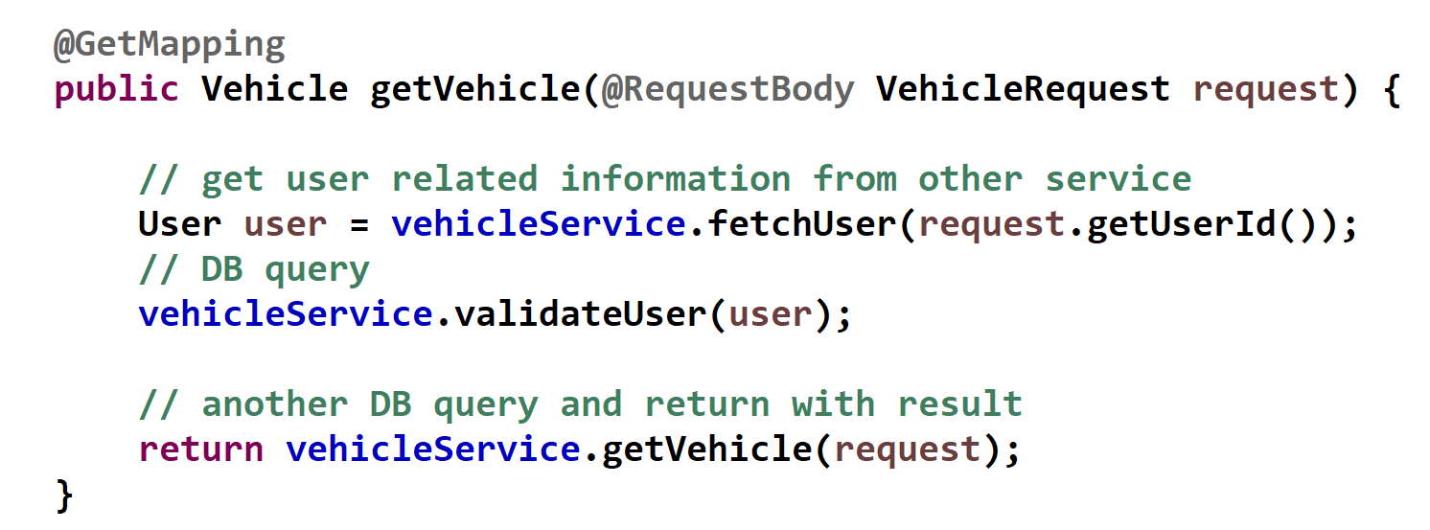
Standard (Platform) Threads
platform
thread
I/O operations
that block
the thread

Slide 6
Virtual Threads
platform
(carrier)
threads
virtual
thread

Slide 7
Standard (Platform) Thread
JVM related
platform threads
operating system
related OS threads
CPUs or CPU cores
that execute the
operations

Slide 8
Standard (Platform) Thread
JVM related
platform threads
operating system
related OS threads
CPUs or CPU cores
that execute the
operations

Slide 9

Standard (Platform) Thread
JVM related
platform threads
operating system
related OS threads
CPUs or CPU cores
that execute the
operations

Slide 10
Standard (Platform) Thread
JVM related
platform threads
operating system
related OS threads
CPUs or CPU cores
that execute the
operations

Slide 11
Standard (Platform) Thread
JVM related
platform threads
operating system
related OS threads
CPUs or CPU cores
that execute the
operations

Slide 12
Standard (Platform) Thread
one standard Java (platform) thread is always associated with a single
OS thread while the thread is running
IT DOES NOT MATTER IF THE THREAD IS BLOCKED, THE UNDRLYING OS THREAD IS ASSIGNED TO THAT THREAD !!!
this is the main disadvantage of standard (platform) threads and
this is why they are not scalable

Slide 13
Virtual Thread
JVM related
virtual threads
JVM related
platform threads
operating system
related OS threads
CPUs or CPU cores
that execute the
operations

Slide 14
Virtual Thread
JVM related
virtual threads
JVM related
platform threads
operating system
related OS threads
CPUs or CPU cores
that execute the
operations

Slide 15
Virtual Thread
JVM related
virtual threads
JVM related
platform threads
operating system
related OS threads
CPUs or CPU cores
that execute the
operations

Slide 16
Virtual Thread
JVM related
virtual threads
JVM related
platform threads
operating system
related OS threads
CPUs or CPU cores
that execute the
operations

Slide 17
Virtual Thread
JVM related
virtual threads
JVM related
platform threads
operating system
related OS threads
CPUs or CPU cores
that execute the
operations

Slide 18
Virtual Thread
when the virtual thread is blocked then JVM saves the state on the heap memory and the platform thread (carrier) executes another virtual thread that is available
JVM related
virtual threads
JVM related
platform threads
operating system
related OS threads
CPUs or CPU cores
that execute the
operations

Slide 19
Virtual Thread
JVM related
virtual threads
JVM related
platform threads
operating system
related OS threads
CPUs or CPU cores
that execute the
operations

Slide 20
Virtual Thread
one virtual thread may be associated with multiple
platform threads at differen times
IF THE VIRTUAL THREAD IS BLOCKED (I/O OPERATIONS) THEN
THE UNDERLYING PLATFORM THREAD IS RELEASED
this is the main advantage of virtual threads and it is possible
because it all happens within the JVM
(no need for OS related operations and to block OS threads)

Slide 21

Virtual Thread
virtual threads are so lightweight that there is no need to
reuse them (no pooling required)
virtual threads are cheap to block – no OS thread is blocked
under the hood because the JVM reuses the carrier thread
use very limired resources (such as memory) because it is used
for limited operations (single HTTP request etc.)

Slide 22
Virtual Thread Pinning
the virtual thread can unmount from it’s carrier – esentially the JVM assigns another virtual thread to the platform thread (carrier)
JVM related
virtual threads
JVM related
platform threads
operating system
related OS threads
CPUs or CPU cores
that execute the
operations

Slide 23
Virtual Thread Pinning
but sometimes the virtual thread can not be unmounted from the carrier thread: it is „pinned” to its carrier
when the virtual thread run code in a synchronized block
when virtual thread runs a native (or foreign) method
JVM related
virtual threads
JVM related
platform threads
operating system
related OS threads
CPUs or CPU cores
that execute the
operations

Slide 24
Virtual Thread Pinning
but sometimes the virtual thread can not be unmounted from the carrier thread: it is „pinned” to its carrier
when the virtual thread run code in a synchronized block
when virtual thread runs a native (or foreign) method
JVM related
virtual threads
JVM related
platform threads
operating system
related OS threads
CPUs or CPU cores
that execute the
operations

Slide 25
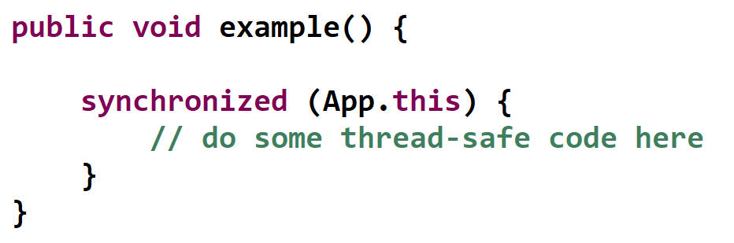
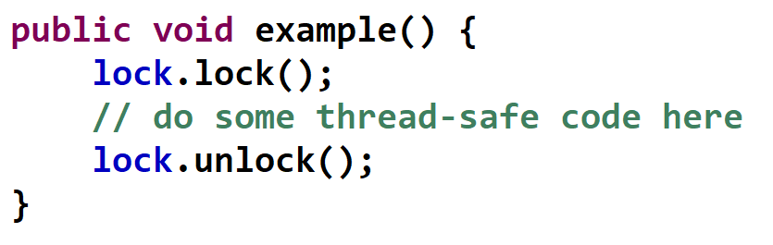
Virtual Thread Pinning
using synchronized block
or method is not advisable
when using virtual threads
using Lock is a better approach
not to pin virtual threads

Slide 26
Virtual Threads
platform
Thread handled by OS
Virtual thread scheduled by JVM
I/O operations
that block
the thread

Slide 27
Futures
main
thread
Future<String> res = service.submit(...);
THREAD POOL
Future object gets the result
running tasks with
multiple threads
PROBLEM: IT DOES NOT NOTIFY WHEN IT IS READY !!!
so we can not chain opertions and combine
the results (as with CancellableFutures)

Slide 28
Futures
main
thread
Future<String> res = service.submit(...);
THREAD POOL
res.get();
Future object gets the result
running tasks with
multiple threads
PROBLEM: the get() method call
blocks the main thread which is (was) not
a good approach !!!

Slide 29
CompletableFutures
main
thread
Future<String> res = service.submit(...);
THREAD POOL
res.get();
Future object gets the result
running tasks with
multiple threads
PROBLEM: the get() method call
blocks the main thread which is (was) not
a good approach !!!

Slide 30
CompletableFutures
Future
synchronous and blocking programming
because the get() method blocks the main thread
CompletableFuture
asynchronous and non-blocking programming
because there is no get() methods that block the main thread
but there are callbacks implemented instead

Slide 31
CompletableFutures
main
thread
CompletableFuture.supplyAsync(...);
THREAD POOL
there is a callback mechanism
implemented under the hood
running tasks with
multiple threads
ADVANTAGE: IT NOTIFIES THE MAIN THREAD WHEN IT IS READY !!!
so we can chain opertions and combine
the results without blocking the main thread

Slide 32
CompletableFutures
main
thread
CompletableFuture.supplyAsync(...);
THREAD POOL
there is a callback mechanism
implemented under the hood
running tasks with
multiple threads
ANOTHER ADVANTAGE: CompletableFuture
handles exceptions
Future does not provide a built-in mechanism for handling exceptionsand exceptions are caught during the get() method
while CompletableFuture deals with exceptions in the chain of asynchronous tasks

Slide 33
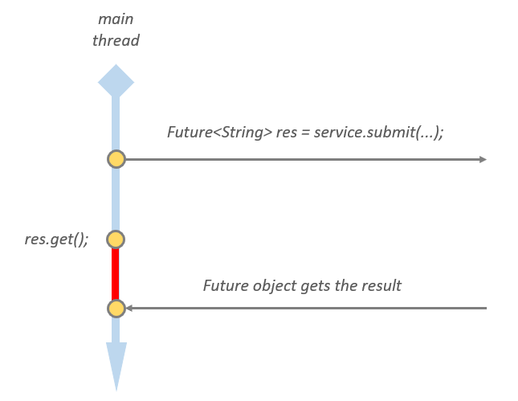
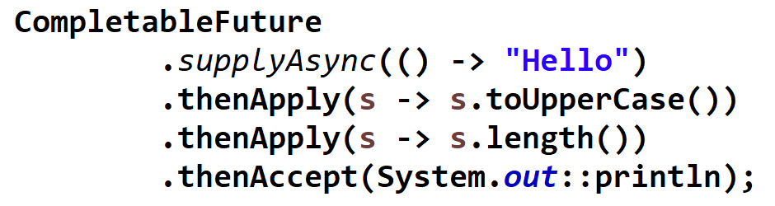
Structured Concurrency
asynchronous and non-blocking programming
is better with CompletableFutures
synchronous and blocking programming
with Future is not good because the
main threads gets blocked
STRUCTURED CONCURRENCY
we define well defined blocks and
wait for all threads to finish execution
BLOCKED THREADS ARE NO LONGER
A PROBLEM WITH VIRTUAL THREADS
PROBLEM: the submitted tasks may be
running indefinitely in asynch manner
+ hard to debug and maintain

Slide 34
Structured and Unstructured Concurrency
main
thread
unstructured concurrency means
that there are a arge number of threads
running that are hard to track
THIS IS THE CASE WITH ASYNCHRONOUS NON-BLOCKING APPROACH
straight-forward error handling is usually
not present and orphaned threads often occur
+ parent-child relationships are not defined !!!
platform
thread
platform
thread

Slide 35
Structured and Unstructured Concurrency
parent thread
start scope
THE MAIN ADVANTAGE OF STRUCTURED
PROGRAMMING IS THAT PARENT-CHILD
RELATIONSHIPS ARE WELL-DEFINED
StructuredTaskScope and Subtask
classes can handle these parent-child relationships
child
threads
we can wait for all the threads to finish
execution before shutdown
join point
we can shutdown when a given child thread fails
we can shutdown when first child thread succeeds
end point

Slide 36


Scaling Applications
if we want to scale applications we
have 2 approaches
VERTICAL / HORIZONTAL SCALING
it can be done quite effectively
with cloud providers
STRUCTURED CONCURRENCY
AND VIRTUAL THREADS
if we use virtual threads instead
of platform threads then we can
handle 10-100x more request
PROBLEM
these cloud providers
are getting more and more expensive
when we run more instances

Slide 37
Continuation
SUBROUTINE / METHOD
subroutine call
subroutine returns some value

Slide 38
Continuation
COROUTINE
coroutine run() call
coroutine returns
yield()
coroutine run() call again
coroutine returns
yield()

Slide 39
Continuation
coroutines may have multiple entry points: whenever we call run()
then we can return to the previous state (where we left off)
in the couroutine we can „freeze” the running of the actual
process with the yield() method
of course we have to store the stack frames (with local variables
and previous coroutine calls) on the heap memory
Continuation is the object that keep the stack and code pointer
so the stack can be recreated when the run() is called again

